Slide 1

ABM SERVICES
p
where passion meets performance

Slide 2

Contents
Introduction
Technical Requirements
Use Case Diagram
Implementation
Output Screens
Future Enhancements
PRESENTED BY PRASAD

Slide 3

Introduction
Welcome to ABM SERVICES, where passion meets performance and where every ride is an adventure waiting to happen. We are thrilled to present a curated selection of top-notch automobiles and bikes that cater to enthusiasts and everyday commuters alike.
PRESENTED BY PRASAD

Slide 4

Technical Requirements
Software Requirements
Bootstrap, Angular
Code Editor ,Web Browser & Font awesome
Dependencies :@angular/forms, @angular/router, rxjs, typescript, @angular/cli
PRESENTED BY PRASAD

Slide 5
Case Diagram
ABM SERVICES
Admin
End User
LOGIN
Products
PRESENTED BY PRASAD
Add To Cart
Add Products
Manage Products

Slide 6
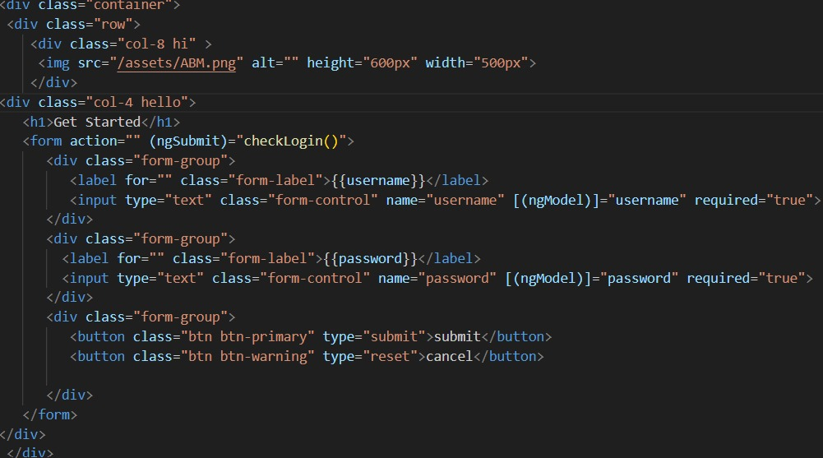
Implementation
Login Method
PRESENTED BY PRASAD

Slide 7
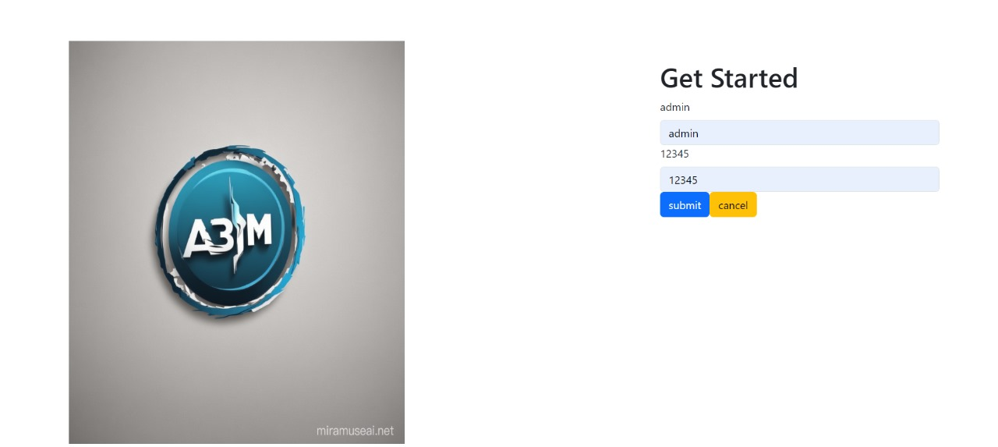
Login Page
PRESENTED BY PRASAD

Slide 8
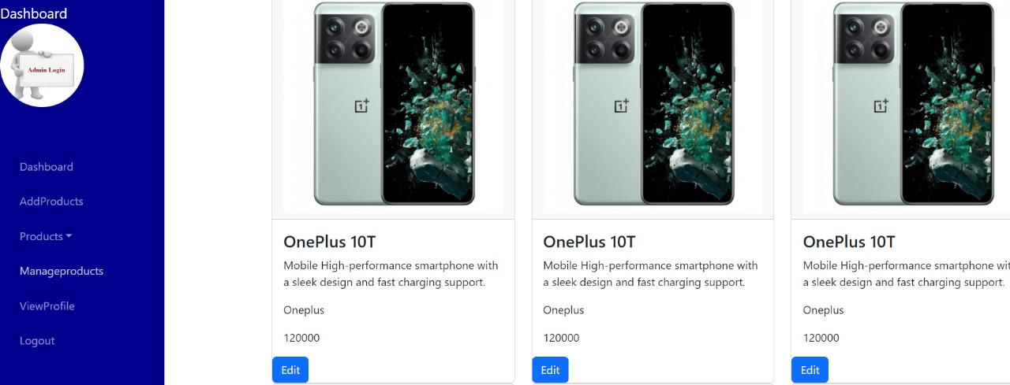
Output
PRESENTED BY PRASAD

Slide 9

Future Enhancement
We will add back End (graphic Interface) to the project and add more security to the project.
PRESENTED BY PRASAD

Slide 10
THANK YOU !!!
PRESENTED BY PRASAD

